Slide 1
Female and Male Reproductive Systems
Biological GoaL:
Production of the next generation of the species
Part 3
This work is licensed under a Creative Commons Attribution-NonCommercial-ShareAlike 4.0 International License.
Notes:
The female and male reproductive systems in mammals are designed to produce gametes – oocytes in the ovaries and sperm cells in the testes, respectively – and to place the oocytes and sperm in close proximity so a zygote (fertilized oocyte) will form and grow into the next generation of the species.
The gametes are the result of meiosis and are haploid. The union of the oocyte and the sperm during fertilization results in a diploid cell.
The number of chromosomes in the haploid gametes and in the diploid offspring is species specific. The human oocyte and human sperm EACH contain 24 chromosomes.

Slide 2
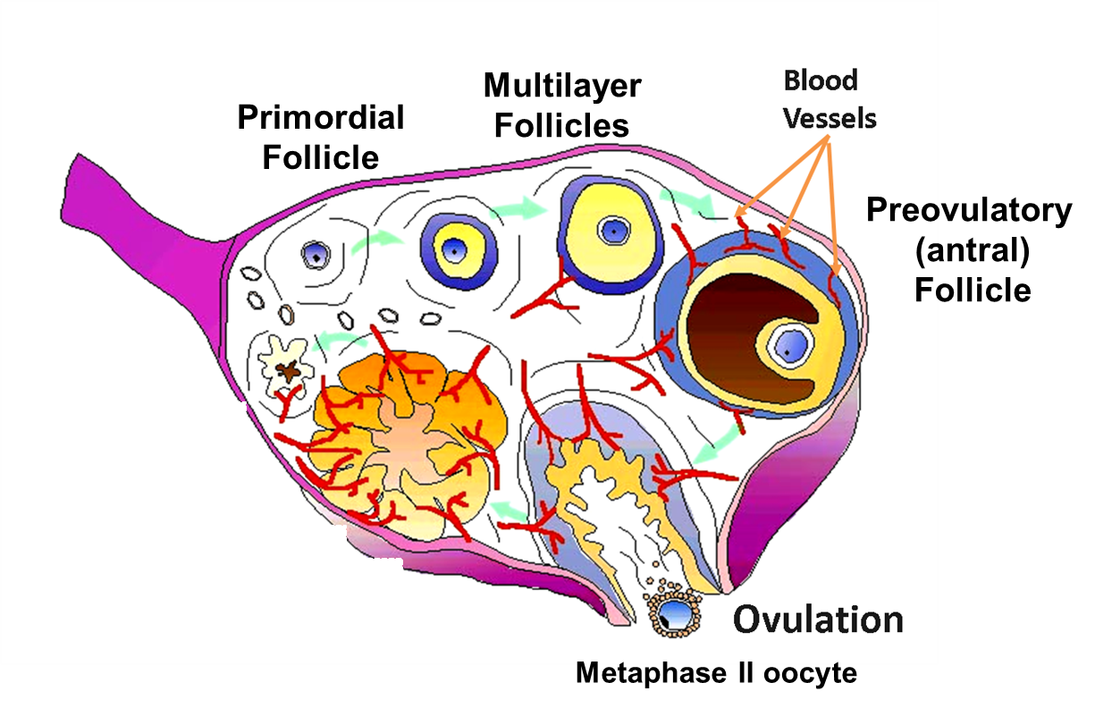
Ovulation
Illustration by Drs. Stouffer and Xu, Oregon National Primate Research Center
Notes:
The surge in FSH and an even larger surge in LH causes the antral follicle to release the secondary oocyte in the process called ovulation (follicle rupture).
The oocyte and antral fluid are released from the follicle into the peritoneal cavity of the abdomen directly adjacent to the fallopian tube.
The oocyte is swept into the fallopian tube by the cilia on the finger-like fimbriae of the fallopian tube which loosely cover the ovary.
The preovulatory follicle now becomes the corpus luteum.

Slide 3
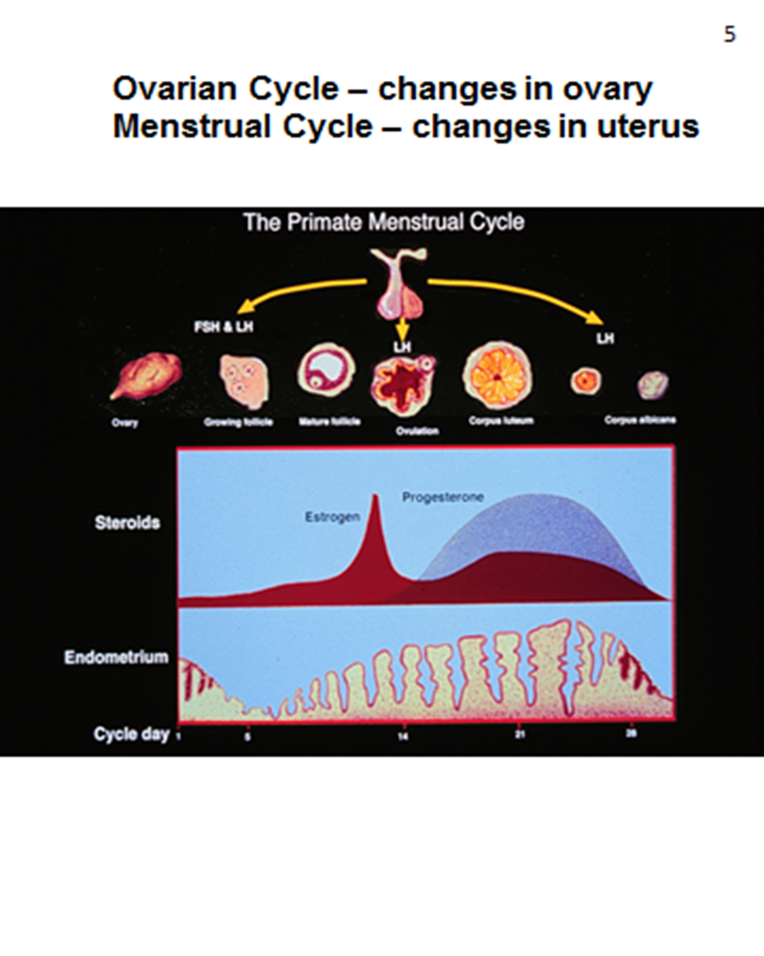
Top: Ovarian Cycle – changes in the ovary during the menstrual cycle
Middle: Hormone Changes during the menstrual cycle
Bottom: Uterine Cycle – changes in the endometrium during the menstrual cycle
Drawing: Joel Ito, Medical Illustrator, ONPRC
Notes:
The follicular phase ‘officially’ begins when the antral follicles are present in the ovary. One antral follicle is selected to become the preovulatory follicle which is the one that will release the oocyte. The follicular phase lasts between 10 – 14 days and is the period of time during which an antral follicle grows to the preovulatory follicle.
Proliferative phase: As FSH and LH begin to increase, so do estrogen levels produced by the antral follicle leading to further growth of the follicle. In response to the increasing estrogen levels, the uterine lining (endometrium) begins to build. The endometrium is well vascularized, but not yet ready to accept an embryo for implantation.
Luteal Phase: The luteal phase of the ovarian cycle begins after the oocyte is ovulated and the remaining somatic follicular tissue forms the corpus luteum.
At ovulation, the high levels of LH cause the remaining follicular tissue to form a corpus luteum which begins to produce progesterone and estrogen, which are necessary for initiation and maintenance of pregnancy. These two hormones also provide negative feedback to the anterior pituitary, thus decreasing the levels of FSH and LH. In this way, development of a new follicle and ovulation are inhibited. The major role of the corpus luteum is to produce the hormone progesterone. If there is no embryo present, the corpus luteum atrophies. The luteal phase typically lasts 14 days if there is no embryo present.
Secretory phase: In addition, high levels of estrogen and progesterone maintain the uterine lining and cause the glands to secrete proteins. If fertilization and implantation of the embryo occurs, the hormonal activity of the corpus luteum is maintained by a hormone similar to LH which is released by the developing embryo.
If no fertilization occurs, the LH levels further decrease and the corpus luteum begins to atrophy. This, in turn, decreases the levels of estrogen and progesterone.
The lining of the uterus is sloughed in menstruation and the cycle begins again.

Slide 4
Menstrual Cycle
The menstrual cycle is the recurring cycle of physiological changes that occur in reproductive age in humans and other primates that is hormonally regulated and results in in ovulation and preparation for the events of fertilization of the mature oocyte and implantation of an embryo.
In other placental mammals, like the mouse, the related recurring female cycle is called an estrous cycle.

Slide 5
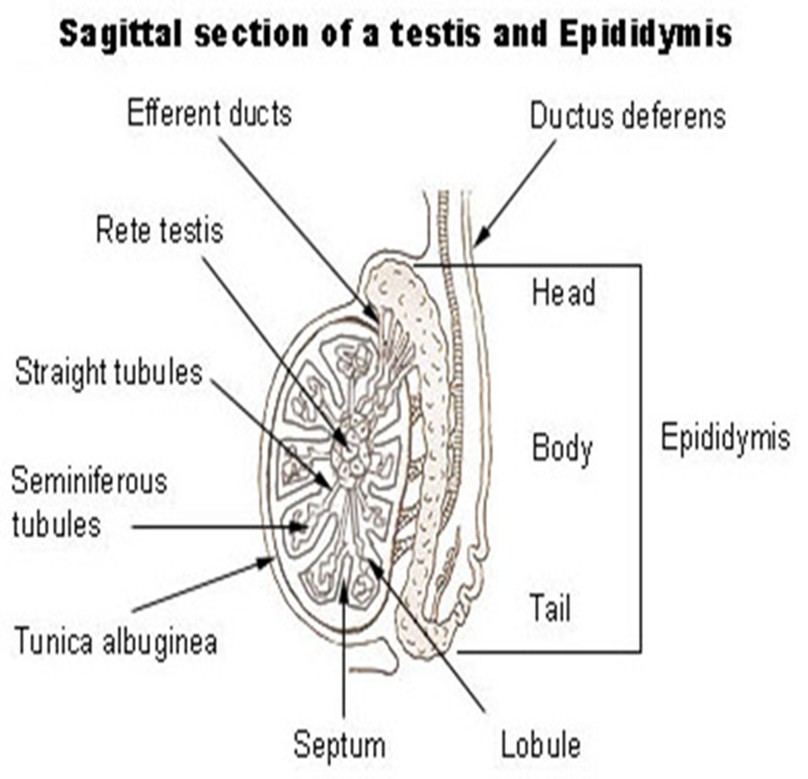
Human Male Reproductive System
http://training.seer.cancer.gov/anatomy/reproductive/male/testes.html
Notes:
The male reproductive system is much less complicated than the female system. The male system consists of a tubular structure that is all connected. It begins with:
a) the scrotum which holds the testes (plural) (testis, singular), the male gonads where the sperm and testosterone are made. The scrotum is a sac-like structure made of skin and connective tissue into which the testes descend during the 9th month of pregnancy or just after birth. Viable sperm cannot be made at body temperature (37ºC) so the position of the testes in the scrotal sac lowers the temperature about 3ºC providing a cool enough place for sperm to be made. The testes are made of 250 to 300 compartments called lobules and each lobule contains one to four tightly coiled seminiferous tubules in which the sperm will develop.
b) The epididymis, which receives the sperm, is a coiled tubule next to the testes where sperm mature and may be stored for a short time.
c) From there, the vas deferens (also called the ductus deferens) transports the mature sperm from the epididymis to the penis.

Slide 6
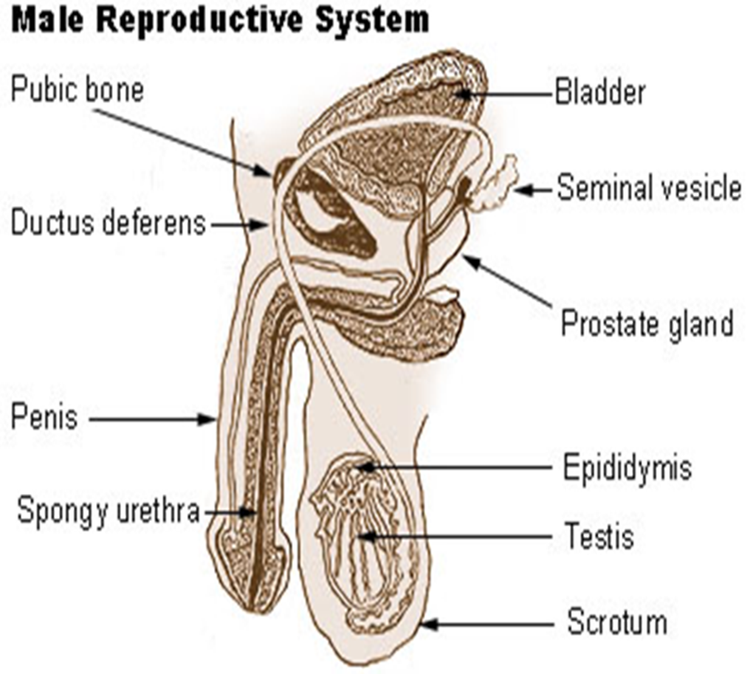
http://training.seer.cancer.gov/anatomy/reproductive/male/
Notes:
d) The penis is the male organ of copulation and, in mammals, of urinary excretion. The urethra is the terminal portion of the male tubular system; at different times, it carries urine from the bladder and mature sperm from the vas deferens through the penis to the outside of the body.
e) The end of the vas deferens joins with the duct of the seminal vesicle to form a short ejaculatory duct which passes into a single prostate gland where it empties into the urethra. In the seminal vesicles, a yellowish viscous alkaline fluid containing fructose (nutrient), ascorbic acid, a coagulating enzyme (vesiculase), and prostaglandins are added. This makes up about 60% of the volume of the semen. The prostate gland secretion is a milky, slightly acidic fluid that contains citrate (nutrient), and several enzymes (fibrinolysin and acid phosphatase) and plays a role in activating the sperm. The prostate gland adds about 33% of the semen volume.
f) The bulbourethral glands are just next to the prostate gland and just prior to ejaculation adds a thick, clear mucus that drains into the urethra to neutralize the acidic urine that might remain in that duct.

Slide 7
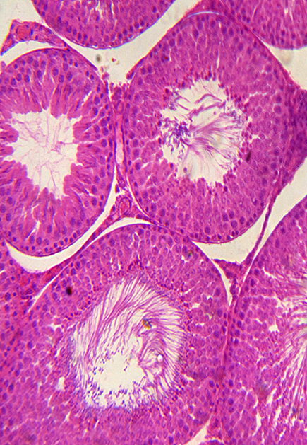
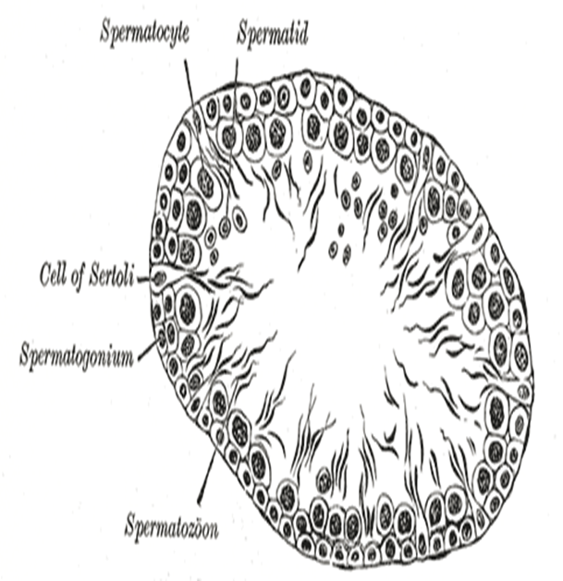
Testis Cross Section Showing Stages of Spermatogenesis
Leydig
Cells
http://upload.wikimedia.org/wikipedia/en/7/71/Rabbit_testis.jpg http://creativecommons.org/licenses/by-sa/3.0/ No changes were made except to label Leydig cells.(left photo)
http://www.wikidoc.org/index.php/Spermatogenesis
http://creativecommons.org/licenses/by-sa/3.0/ No changes were made. (right drawing)
Notes:
Unlike the female ovaries which contain all of the oocytes at birth, the male testes contain stem cells located along the outer most edge of the seminiferous tubules in the testes. Millions of sperm at made at a time.
Spermatogonia (plural for spermatogium) are undifferentiated Type A (d) stem cells in the testes which divide by mitosis to produce Type A (p) cells and more Type A (d) cells. Type A (p) cells divide by mitosis to produce Type B cells which divide by mitosis to produce primary spermatocytes.
The primary spermatocytes undergo meiosis I to form two equally sized secondary spermatocytes. The secondary spermatocytes each undergo meiosis II to form four equally sized haploid (monoploid) spermatids.
The spermatids continue to develop through cell differentiation into four mature haploid sperm cells flagellated for motility.

