Slide 1
Completing the PhD in BCB or in HCIN
January 7, 2020 PRESENTED BY: Diane Doctor, MLIS, Educational Programs Coordinator
Dept. of Medical Informatics & Clinical Epidemiology

Slide 2
Year 1 Research Rotations
Must complete 2 BMI 601 Research Rotations
Variable credits.
Included in summer term minimum of 5 credits for NLM Fellows.
Minimum 1 credit for other PhDs.
Submit 60X Form
Complete Evaluation Form at end of term.
Pass or No Pass
2

Slide 3
Year 1-2 Coursework
Follow recommended schedule of Required and Individual Competency classes.
Take 12 credits of Advanced Research Methods and 12 credits of Cognate (clinical domain) prior to qualifying exam. These are different for every student. Consult your faculty advisor.
Download all course content from Sakai to study for comprehensive and qualifying exams.
3

Slide 4
Year 1-2 Coursework
Taking classes outside of DMICE:
Must be approved by your advisor.
SoPH (BSTA, PHE) has different registration processes depending on the course. You may need to register as a non-degree student at PSU.
PSU registration process differs from ours.
If course is not on Memorandum of Understanding (MOU), Fellows will need to submit a Request for Funding.
Must formally transfer in PSU credits upon completion (need transcript).
4

Slide 5
Comprehensive and Qualifying Exams
Exam Prep BCB and HCIN:
Review Qualifying Exams BCB or Qualifying Exams HCIN document on Student Resources page: https://www.ohsu.edu/school-of-medicine/medical-informatics-and-clinical-epidemiology/student-resources
Andrea schedules a “Nuts and Bolts” meeting to explain process.
Mock orals:
BCB
Mock oral exam early summer of Year 2
HCIN
Mock oral exam spring of Year 1
5

Slide 6
Comprehensive and Qualifying Exams
Exam Timeline - BCB
Comprehensive, 2-day written exam at end of summer (August or September) of Year 2; exam covers all coursework.
Oral Qualifying Exam 3-4 weeks later. May take exam if lacking 1 Cognate or Advanced Research Methods class.
Pass
Conditional Pass (remediate)
Fail (retake in 6 months)
6

Slide 7
Comprehensive and Qualifying Exams
Exam timeline - HCIN:
Mock oral exam mid-summer of Year 1
Comprehensive Exam based on journal articles at end of second summer term (Aug.-Sept.)
Qualifying Exam by student request, by end of Year 2; may take exam if lacking 1 Cognate or Advanced Research Methods class
Pass
Conditional Pass (remediate)
Fail (retake in 6 months)
7

Slide 8
Naming your PhD Mentor
Must name your Mentor 1 term after passing Qualifying Exam.
Mentor must be DMICE faculty member
Must be on Graduate Faculty
Must have a doctoral level degree (M.D., Ph.D., etc.)
Complete Mentor Assignment Form – PhD programs (see Diane)
8

Slide 9
Forming your DAC
Review SOM Dissertation Advisory Committee (DAC) Policy https://www.ohsu.edu/sites/default/files/2019-03/DAC%20Guidelines.pdf
Name your DAC
If you’re not sure who should be on your DAC, speak to your mentor.
They should bring different areas of expertise to your research.
Review Faculty Research Interests document
Minimum of 4 members
9

Slide 10
Forming your DAC (cont.)
Name your DAC (cont.)
At least 3 members must be on SOM Graduate Faculty (not the same as OHSU Faculty)
At least 3 members (including Chair) must have DAC experience
May have 1 outside member (non-Graduate Faculty or non-OHSU)
Dissertation Mentor may not be the Chair
Submit Request for Dissertation Advisory Committee (DAC) form https://www.ohsu.edu/school-of-medicine/graduate-studies/forms-and-policies
10

Slide 11
Symposium
Register for 3 credits of BMI 657 Symposium.
Schedule presentation date with Lynne; Thursday at 11:30 preferred.
Invite 3 faculty members to attend.
They may be prospective DAC members.
Purpose of symposium is to present lit review, identify gaps in the research, possible research questions, obtain feedback.
11

Slide 12
Considering The Final Deliverable
Recommended: prepare dissertation in the form of 3 publishable manuscripts
Beginning with students admitted in 2019-2020, requirement is to submit manuscripts to a peer-reviewed journal or to a conference that publishes full papers in proceedings and that is indexed in Medline, during Years 3 and 4
Manuscripts do not have to be accepted prior to graduation
See Thesis/Dissertation as Manuscript Option document on Student Resources page in “Ph.D.” section for details.
12

Slide 13
First term of BMI 601 Dissertation
Required by SOM to have a DAC meeting at least once every 6 months; we recommend once every quarter
Meet with mentor every 1 or 2 weeks
Schedule 1 1/2 hours for first DAC meeting early in the term
Prepare 5 or 6 slides (includes Slide 1 template on next slide)
13

Slide 14
First term of BMI 601 Dissertation (cont.) Slide 1 Template:
Purpose of today’s meeting:
Present 5-6 slides outlining current status of my research
Summarize literature review
Identify gaps in the research
Suggest possible research questions
Obtain feedback from Committee regarding possible research questions
Obtain feedback from Committee regarding possible specific aims (2)
Obtain additional feedback to help me develop my proposal
Next steps for this term:
Regular meetings with advisor
Submit written proposal and slides to Committee for review
Pre-defense meeting (rehearsed, timed 40-minute presentation with slides)
Public proposal defense by end of term
14

Slide 15
First term of BMI 601 Dissertation (cont.)
Present current state of your research
Purpose of first DAC meeting is to obtain input from committee as you develop your proposal
Complete DAC Meeting Summary Form
Meet with mentor regularly for remainder of term
15

Slide 16
First term of BMI 601 Research (cont.)
Prepare your proposal
Include:
Background
Specific Aims
Methods
Limitations
Anticipated Results
Bibliography
See Guidelines and regulations for Completion of Master’s and PhD. Degrees: https://www.ohsu.edu/school-of-medicine/graduate-studies/forms-and-policies. Click on “Degree guidelines”.
16

Slide 17
First term of BMI 601 Research (cont.)
Begin process to obtain IRB approval: eirb.ohsu.edu
Defend your proposal
Schedule 1) pre-defense and, 2) public defense
Hold pre-defense meeting with Committee. If approved, obtain signed Pre-defense Approval Form.
Proprietary information? Complete Step 1 (“Go/No Go”) Form if you do not want to livestream or record
Defend proposal in BICC 124
17

Slide 18
Second, third and fourth terms of BMI 601 Research
Research, data collection, data synthesis, writing
Meet with mentor regularly
Meet with DAC at least once each term to present current status of research (with slides)
Complete DAC Meeting Summary Form
18

Slide 19
Final term--BMI 603 Dissertation
Schedule public dissertation defense with Lynne
Prepare the dissertation per SOM Guidelines and Requirements. Include:
Introduction
Methods
Results
Discussion
Summary and Conclusions
Areas for future research
Bibliography
Appendices
19

Slide 20
Final term--BMI 603 Dissertation (cont.)
Formatting and citation:
See Guidelines for preparation of dissertation and thesis for formatting rules. Be consistent with formatting.
Choose one citation style and be consistent
Vancouver (preferred)
APA
MLA
Examples of Vancouver style https://www.nlm.nih.gov/bsd/uniform_requirements.html
Online Writing Lab (OWL) at Purdue https://owl.english.purdue.edu/owl/
20

Slide 21
Final term--BMI 603 Dissertation (cont.)
If final deliverable is 3 manuscripts in publishable format:
Use each manuscript as the basis for a chapter of the dissertation
Follow guidelines of the journal of choice
Expand on Introduction and Background sections
Your journal may limit number of references; dissertation does not
Each journal has its own specifications for Appendices, Tables, Illustrations, Abbreviations, Typing
21

Slide 22
Final term--BMI 603 Dissertation (cont.)
Form Oral Examination Committee
Must add a new member who was not on the DAC
At least one member must be from outside student’s program
Dissertation mentor may not be Chair
22

Slide 23
Final term--BMI 603 Dissertation (cont.)
Send slides and write up to Committee two weeks before pre-defense
Pre-defense meeting with Committee
This is a timed, rehearsed dry-run of public defense (40 minutes)
If approved, obtain signed Pre-defense Approval Form
Public thesis defense in BICC 124
Followed by private 30-minute oral examination with Oral Examination Committee
Submit signed Oral Examination Certification within 48 hours of defense
23

Slide 24
If you need an additional term of BMI 603 Dissertation…
Continue to register for 1 credit of BMI 603 Dissertation until you turn in final writeup
If you do not submit write up 6 months after defending, you will need to re-defend
24

Slide 25
Submit final documents
Certificate of Approval page signed by committee members (becomes page 2 of dissertation). Electronic signatures accepted.
PDF of thesis to:
ethesis@ohsu.edu (library)
Diane
Document Submission Form to ethesis@ohsu.edu
Electronic Publication Permission Form to ethesis@ohsu.edu:
Immediate Release, or
Delayed Release (3 years)
25

Slide 26
Dissertation Binding
Required by DMICE
Order 2 bound copies of dissertation at www.thesisondemand.com
1 for mentor
1 for department
May order extras for yourself (requires separate order)
26

Slide 27
Congratulations, Doctor!

Slide 28
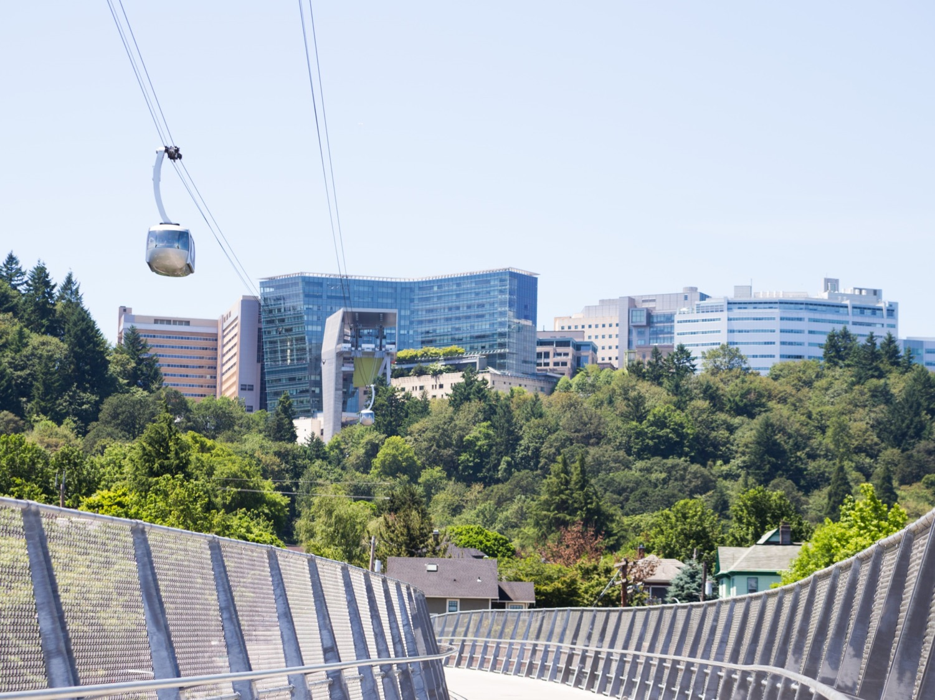
Questions?

