Slide 1
When I Should Visit My Doctor
Module 3

Slide 2
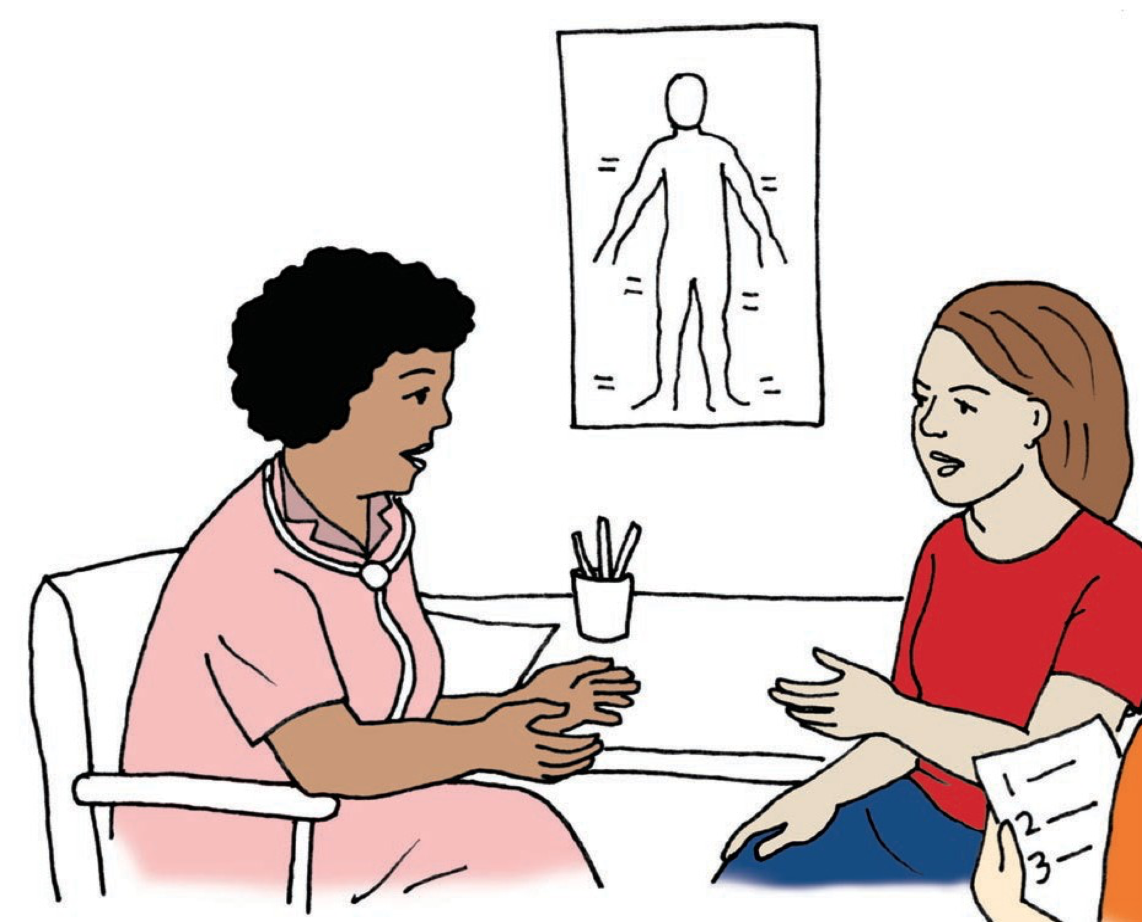
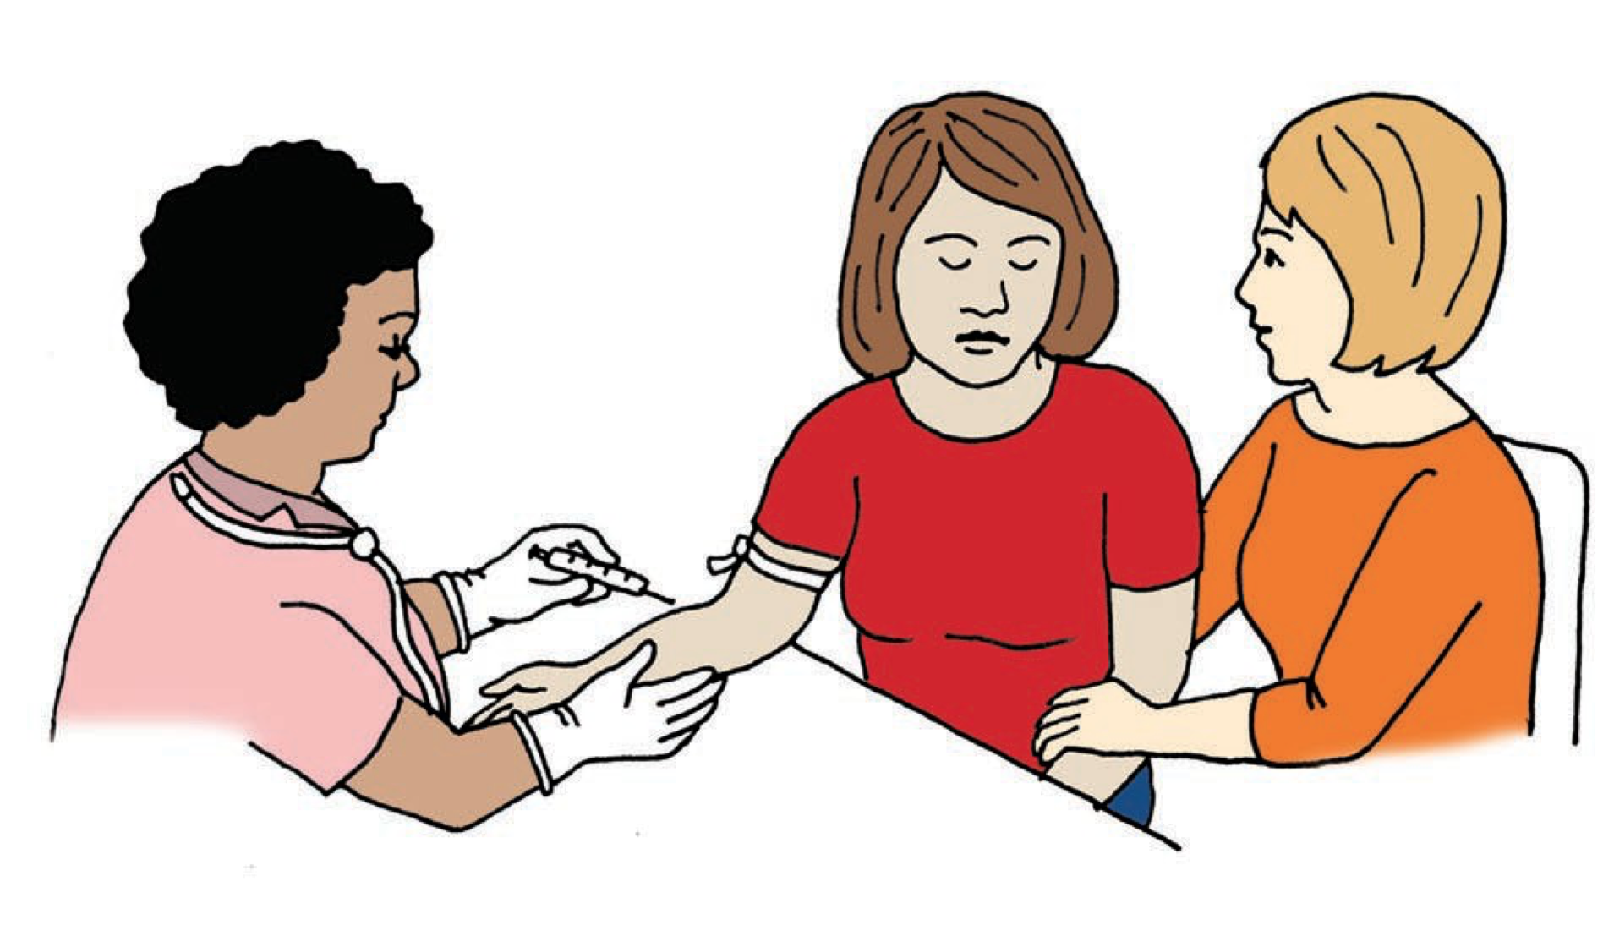
Health Check-ups
Check-ups:
You should go for health check-up one time a year, even if you feel OK. The doctor will talk to you and check your heart, eyes, ears, and other parts of your body.
The doctor also might want to run some tests that may involve taking some blood.

Slide 3
What are some different types of check-ups you need on a regular basis?

Slide 4
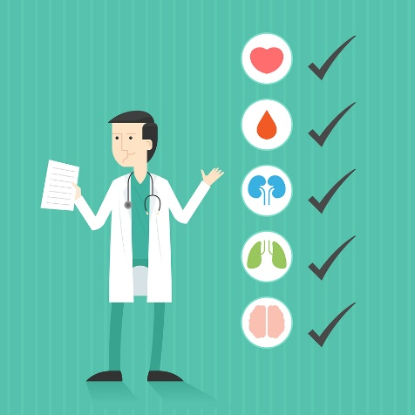
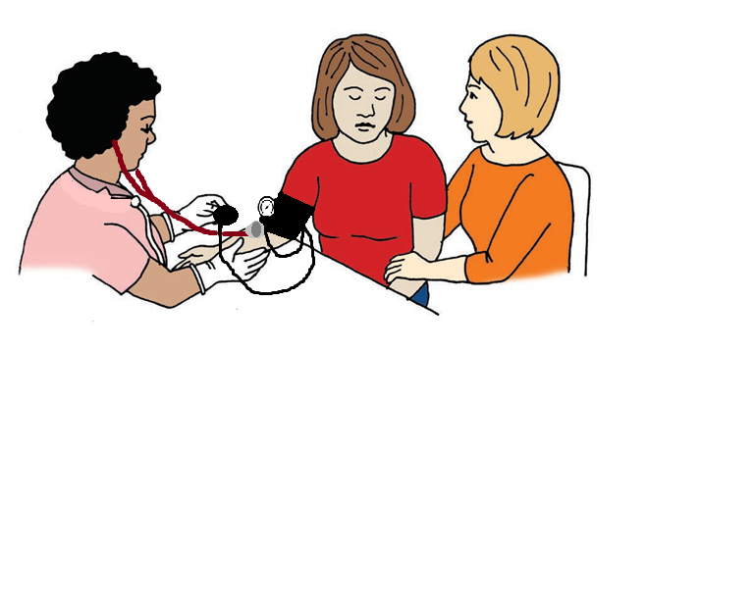
Types of Check-Ups
Different types of regular check-ups include:
Annual Check-Up:
An annual check-up may also be called a wellness visit.
Going to a check-up once a year helps to prevent future health problems and gives you a chance to meet with your doctor and ask questions.
Routine Eye Exam:
An eye exam involves a series of tests to check for any potential eye and vision issues.
You should have a vision exam every 1-2 years. Ask your doctor what they recommend for you.
E
A B F G
J P Q W R O
M V X C E L S Z
P R T Y N U A G Q X
C F B H J S A Q R T P O

Slide 5
Types of Check-Ups Continued
Twice Yearly Dental Visit:
A dental exam involves cleaning your teeth and having your teeth and gums examined for cavities and gum disease. You should visit your dentist every 6 months or at least 1 time a year.
Specialist Visits:
Depending on your specific needs, your doctor may refer you to a specialist who focuses on one area of health care. Some types of specialists include:
Audiologist (hearing)
Cardiologist (heart)
Optometrist or ophthalmologist (eyes/vision)
Neurologist (nervous system)

Slide 6
What are some types of screening tests you may have for preventative care?

Slide 7
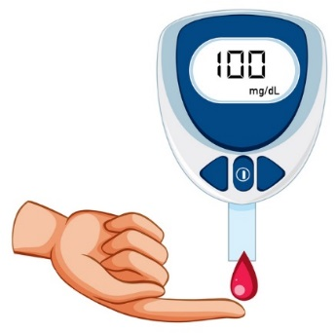
Preventative Care
Preventative care is the care you receive to prevent illnesses or diseases. It includes screenings and immunizations to help you stay healthy.
Here are two examples of types of screening tests, that your doctor may perform.
Diabetes: A blood test to check your glucose (sugar) levels. This screening test provides an early warning sign of high blood sugar levels. It can help you find out whether or not you are at risk for diabetes.
Heart health: A test of your blood pressure and/or cholesterol. A blood pressure test is important to see if you are at risk for a heart attack, stroke, and/or heart failure. Testing for cholesterol can help reduce your risk of heart disease.

Slide 8
Preventative Care
What are some other types of preventative care are:
Reproductive
Mental Health
Breast Health
Prostate Health
Immunizations

Slide 9
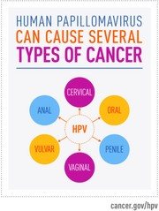
Preventative Care
Reproductive health: If you are sexually active or want to be, it is important for you and your partner to be tested for sexually transmitted infections (STIs) before beginning sexual activity. This prevents STIs from spreading and allows for any necessary treatment(s).
Ways to detect cancer is to get a Pap smear and pelvic exam or testicular exam to identify any changes that may be of concern.
HPV is a type of STI that can cause cancer. All genders should get an HPV test to help identify risk of cancer and prevent spreading of STIs.

Slide 10
Preventative Care
Mental health: If you are feeling sad, anxious, or angry for two weeks or more, speak to your doctor about it. They can help you figure out ways to feel better.
Breast health: A breast exam is important in helping to identify cancer early. Self-examinations as well as those done by your medical professional are both important for detecting breast cancer. Other ways to detect breast cancer are with a mammogram or an ultrasound. Talk with your medical professional about when, and what type of exam, you should get.
Prostate screening: Depending on your age and/or risk factors, you may need to get a prostate exam, which helps detect warning signs of prostate cancer.

Slide 11
What are some types of immunizations you may need?

Slide 12
Preventative Services
Immunizations: Immunizations help protect you against a variety of contagious diseases. Certain immunizations are recommended for your age and at different times throughout your life.
Some examples of immunizations are:
Influenza (flu)
Measles, mumps, and rubella (MMR)
Diphtheria, tetanus, and pertussis (DTaP)
Chicken pox
Pneumonia
Polio

Slide 13
Besides what we already talked about, what are some other reasons you might need to see a doctor?

Slide 14
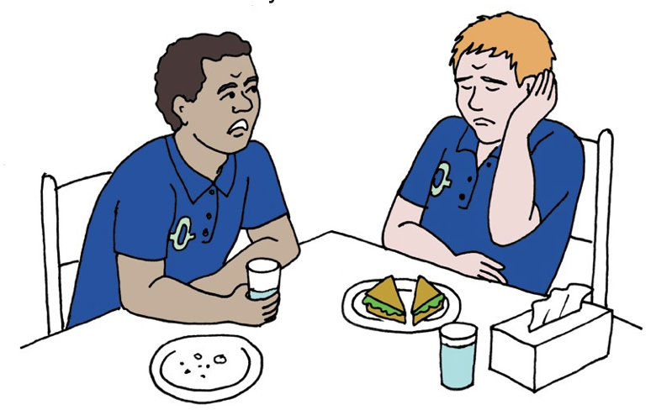
When You are Sick or Have Pain
Some reasons you may need to see a doctor are:
If you are not feeling well or are experiencing pain or discomfort, DO NOT WAIT to see your doctor!
See Module 6: Signs of Sickness to learn about the signs and symptoms of different illnesses.

Slide 15
What Did I Learn?
I can take charge my health when I:
Know what check-ups I need.
Am able to receive preventative care.
Know what screenings I need.
Have immunizations to protect me.
Know who to call and what to do when I am sick or in pain.

Slide 16
Created in partnership with:
Oregon Self Advocacy Coalition,
Oregon Health and Science University, and
Oregon Council on Developmental Disabilities
This PowerPoint is adapted from materials developed by NSW Council for Intellectual Disabilities (2009), Australia.
The toolkit and its components were supported in part by the Grant or Cooperative Agreement Number DD000014, funded by the Centers for Disease Control and Prevention and by the University Center Excellence in Developmental Disabilities Administration on Community Living Grant #90DDUC0039-03-02. Its contents are solely the responsibility of the authors and do not necessarily represent the official views of the Centers for Disease Control and Prevention, Administration on Community Living, or the Department of Health and Human Services.

