Slide 1
Being a Self-Advocate
Module 1

Slide 2
What does it mean to be a self-advocate?

Slide 3

Being a self-advocate
Being a self-advocate means:
Having your voice heard,
Knowing your rights,
Asking for what you want, and
Being able to achieve your goals and live independently.
My Rights
My Health
My Choices

Slide 4
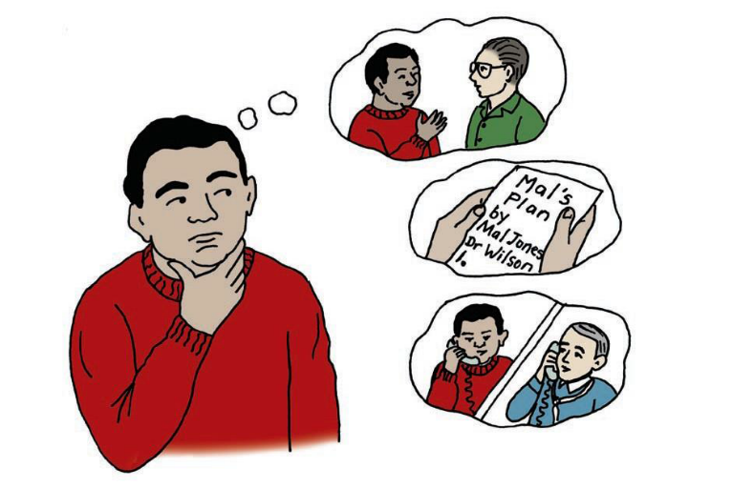


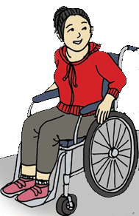
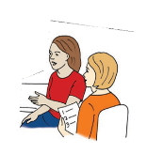

Who Can Be a Self-Advocate?
EVERYONE!

Slide 5
What are some ways you can advocate for yourself?

Slide 6

When and Where to Be a Self-Advocate
You can advocate for yourself so that you can:
Go to school where you want to
Know about your political representative and vote for who you want to
Live where you want to live
Use the transportation that is best for you
Spend time with who you want to spend time with
Spend money on what you want to buy
Work where you want to work
Be treated how you want to be treated

Slide 7
What are some of your rights and responsibilities when it comes to your health care?

Slide 8
Oregon Health Plan: Rights and
Responsibilities
YOUR RIGHTS:
Be treated with dignity, respect, and consideration for privacy.
Choose or change doctors.
Choose not to receive care.
Be involved and informed in creating a plan
Have written materials explained in a way that you can understand.
Have a friend, family member, or support person with you during office visits.
Have access to urgent and emergency services 24 hours a day, 7 days a week.

Slide 9
Oregon Health Plan: Rights and
Responsibilities
YOUR RESPONSIBILITIES:
Choose a provider or clinic.
Treat all providers and their staff with respect.
Be on time for appointments.
Call in advance to cancel or if you will be late.
Set up your own doctor appointments.
Use urgent care and emergency services appropriately.
Give accurate information to your doctor.
Follow your doctor’s directions and seek help if you do not understand the directions.

Slide 10
What Did I Learn?
I can take charge of my health when I:
Self-advocate by speaking up for myself to make sure my rights are recognized and respected.
Understand that EVERYONE can be a self-advocate.
Self-advocate about decisions that are being made about my life.
Self-advocate in all areas of my life.
Understand that being a self-advocate helps my quality of life.
Realize that I know my body the best and have the right to make decisions when it comes to my health care.

Slide 11
Self-Advocacy and Health Care
You are now ready to explore the rest of the modules in this Toolkit.
The following modules will help learn how to advocate for your health and health care and be a great self-advocate.
You are on your way to living a the healthiest version of yourself!

Slide 12


Created in partnership with:
  Oregon Self Advocacy Coalition,
  Oregon Health and Science University, and
  Oregon Council on Developmental Disabilities
The toolkit and its components were supported in part by the Grant or Cooperative Agreement Number DD000014, funded by the Centers for Disease Control and Prevention and by the University Center Excellence in Developmental Disabilities Administration on Community Living Grant #90DDUC0039-03-02. Its contents are solely the responsibility of the authors and do not necessarily represent the official views of the Centers for Disease Control and Prevention, Administration on Community Living, or the Department of Health and Human Services.

