Slide 1
OHSU SoM Faculty Development
Upcoming Opportunities
UPDATED: April 21, 2025

Slide 2
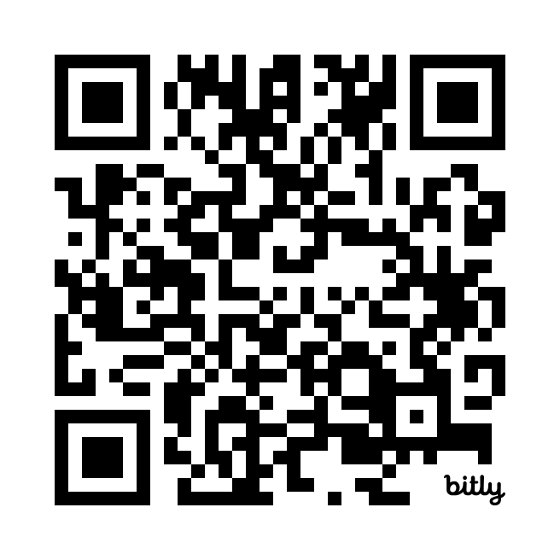
2025 Faculty Development Summit
Registration open for May 23 event. | Learn more and register
P&T Peer Mentorship Program
Seeking mentees and mentors for the current promotion year cycle | Sign up now to be paired in early Spring
Early Career Advancement Program
May 22, noon – 1:30 p.m. | Conflict Resolution and Negotiation
CV/Educator’s Portfolio Drop-in Sessions: Bring your CV/EP and get feedback from experienced faculty!
April 28
Work life Design Coaching Circles
April 24, 10 a.m. – Noon | Career Opportunities
May 22, 10 a.m. – Noon | Grow Forward
June 12, 10 a.m. – Noon | Thrive
Innovation for All: A Path Forward
May 1, 1 – 2 p.m. | Identifying and Innovating for Unmet Needs
May 8, 1 – 2 p.m. | Turning Your Research into Real-World Impact with Technology Transfer
May 15, 1 – 2 p.m. | Exploring Beyond Academia: Career Paths for Ph.D.’s
May 29, 1 – 2 p.m. | Rethinking Funding: Tapping into New Streams of Research Support

Slide 3
School of Medicine Faculty Development Website
https://www.ohsu.edu/school-of-medicine/faculty-development

